Slide 1


In collaboration with
Centres of Excellence
Digital Directory Launch
Colette Munroe – NSO Supply Chain Advisor
Tom Chant – SMI CEO
October 2025
Access the CoE Digital Directory here

Slide 2
Centres of Excellence – Introduction
STRAPLINE:
This Centres of Excellence (CoE) initiative is designed to strengthen the UK Shipbuilding Enterprise by:
  increasing visibility of existing national capabilities
  reducing duplication of effort
  fostering collaboration between industry, government, and academia.
It aims to connect organisations, share best practice, and encourage innovation to address strategic challenges and maximise UK content
VISION:
The vision for this work is to ‘cultivate a strong community of practice between Centres of Excellence, Industry & Government to maximise opportunities across the UK Shipbuilding Enterprise’
Help connect industry with Centres of Excellence
BACKGROUND:
The UK Shipbuilding Enterprise has a wealth of expertise and best practice, but it is recognised that there is a need to understand where there are further opportunities for collaboration around Centres of Excellence (CoE) to deliver benefits.
If you are not in the world of Centres of Excellence, it is hard from an industry point of view to understand what exists.
To this end, a Centres of Excellence Task and Finish Group was formed.
The Task and Finish Group was sponsored by the Shipbuilding Enterprise for Growth (SEG) forum.
The Task and Finish Group comprised of a breadth of Industry representatives across the Shipbuilding Enterprise; led by Industry – for Industry.
Engagement took place with industry with a number of recommendations made - one of which was to gain a better understanding of existing Centres of Excellence.

Slide 3
Centres of Excellence – Aims
VISION
Cultivate a strong community of practice between Centres of Excellence (CoE), Industry & Government to maximise opportunities across the UK Shipbuilding Enterprise
AIM
Provide Industry with a mechanism to increase visibility of what CoE capabilities exist which can support the development & signposting of collaboration opportunities
Provide a best practice guide for CoE engagement across UK Shipbuilding Enterprise
Drive an interactive CoE community of practice, encourage knowledge sharing, promoting collaborative behaviours & connections
DEFINITION
A Centre of Excellence (CoE) is a team, a shared facility (physical or virtual) or an entity focused on innovation and delivery by providing leadership, sharing best practices, conducting and sharing research, demonstrating capabilities,
and offering support and/or training for a focus area of the shipbuilding enterprise
KEY DELIVERABLE OBJECTIVES
Develop an accessible, on-line, curated CoE Digital Directory of existing UK Shipbuilding Enterprise CoEs
Develop a CoE Playbook
to provide a best practice guide to maximise engagement across the shipbuilding enterprise
Develop an integrated
CoE Community of Practice network
Provide a mechanism to signpost & increase visibility of CoE opportunities
Notes:
Vision
The vision for this work is to ‘cultivate a strong community of practice between Centres of Excellence, Industry & Government to maximise opportunities across the UK Shipbuilding Enterprise’
We want to help connect industry with Centres of Excellence
There are a number of key deliverables to enable this vision which will be discussed in greater detail.

Slide 4
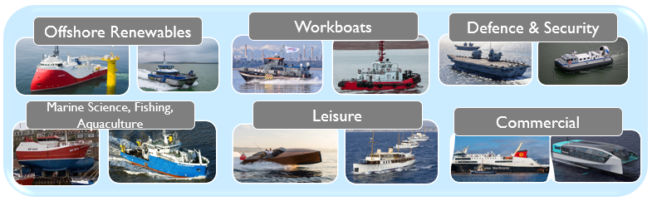







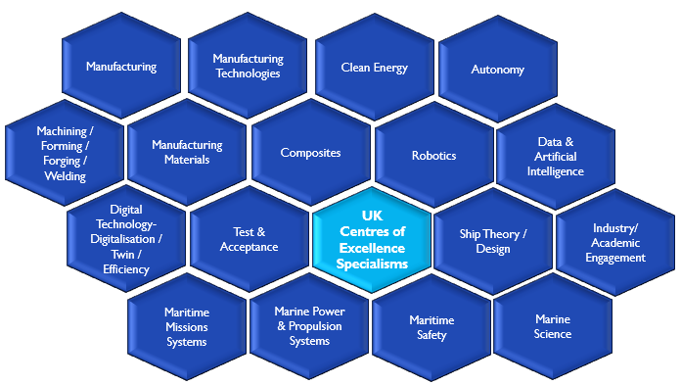
Centres of Excellence Engagement – Target Audience
Industry
Government Departments
UK Centres of Excellence
Shipbuilder
Boatbuilder
Operator
Maintenance Support
Repair, Conversion
Supply Chain OEMs
The target audience for these activities is 3-fold:
Centres of Excellences themselves, industry and government.
The target audience will vary, comprising of organisations which are:
already an existing CoE
seeking to become a CoE
Industry Small and Medium Enterprises through to larger organisations
Organisations from within related industries looking at how they can collaborate with CoEs to help solve challenges
Government departments being aware of CoEs
Notes:
The target audience for these activities is 3-fold – the Centres of Excellences themselves, industry engagement and government awareness.
This is across the wide range of the shipbuilding enterprise industry sector from Workboats, Offshore Renewable Vessels, to Defence, Aquaculture, Commercial and Leisure.
A number of Centre of Excellence Specialisms have been identified. For example, the focus on Clean Energy, Autonomy, or Manufacturing Materials

Slide 5
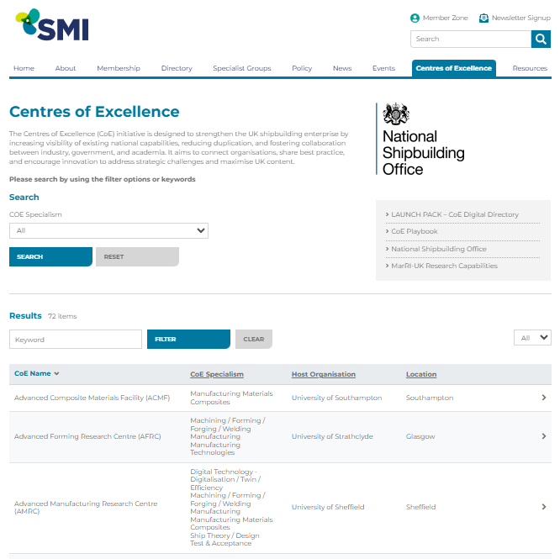
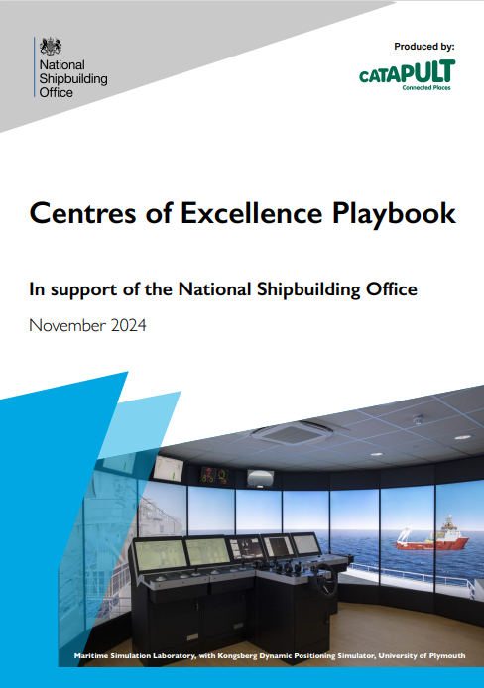










Centres of Excellence - Key Deliverables
There are 3 main strands of scope to
enable the vision
CoE Digital Directory
CoE Playbook
In collaboration with
CoE
Community of Practice
In collaboration with
In collaboration with
Provide a best practice guide to maximise engagement across the shipbuilding enterprise
Provide visibility of what CoE capabilities exist
Act as the communication channel to wider industry & government to provide a mechanism to signpost & increase visibility of CoE opportunities
Notes:
Centres of Excellence – Key Deliverables
There are 3 main strands to the scope to enable the vision
1) Developing a CoE Digital Directory
2) Providing a Centres of Excellence Playbook
and most importantly
3) Encourage engagement and build a strong community of practice across Centres of Excellence, Industry and Government
We will go into each in more detail.

Slide 6
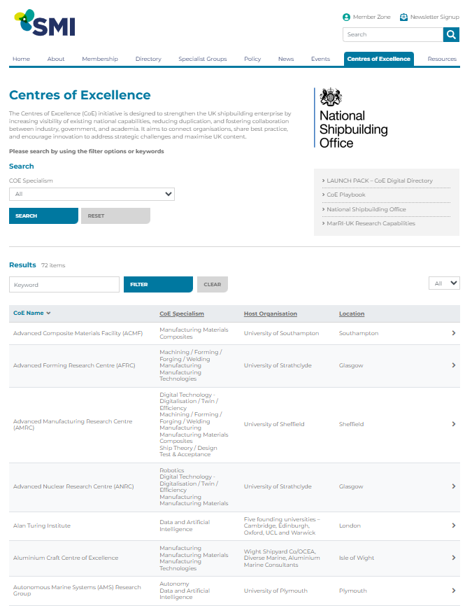
Centres of Excellence - Digital Directory
In collaboration with
The CoE Digital Directory is sponsored by the National Shipbuilding Office;
developed in collaboration with SMI.
Dedicated section tab forms part of the SMI website for ease of access
Aims to help increase visibility of what CoE capabilities exist, improve accessibility, and have clear points of contact in host organisations
Developed to understand existing Centres of Excellence specialisms which can support the UK Shipbuilding Enterprise
CoE Digital Directory
Access the CoE Digital Directory here

Slide 7
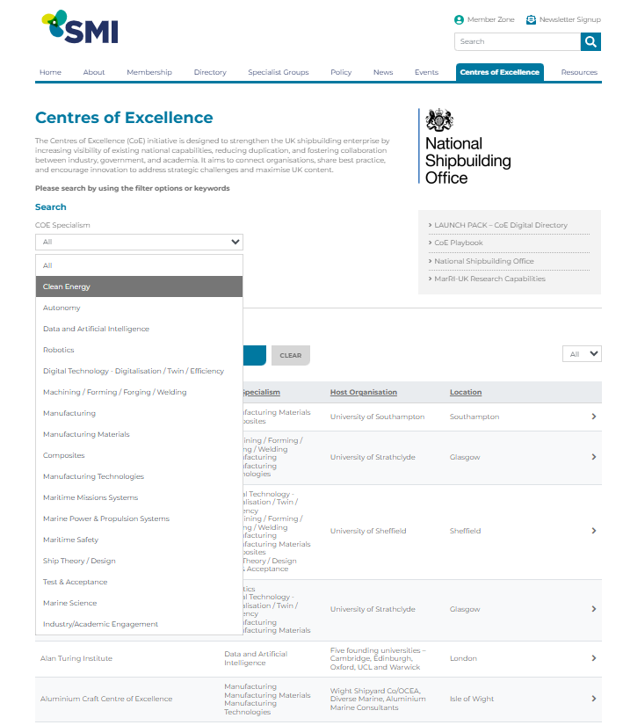
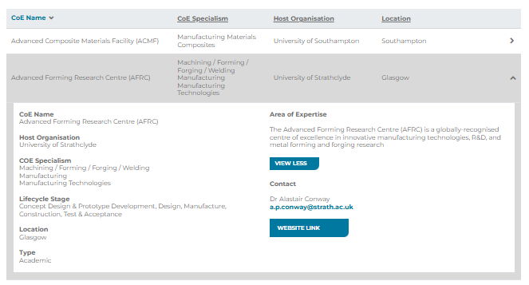
Centres of Excellence (CoE) - Digital Directory Content
In collaboration with
Website: https://www.maritimeindustries.org/centres-excellence
The CoE Directory will be ‘curated’, i.e. information will be maintained and managed
Data cleansing administration will be conducted to keep data up to date & ensure data is correct
Field web enquiries
CoE Digital Directory Tab
Launch Pack presentation overview
Link to MarRI-UK R&D Programmes
Detailed information provided per CoE:
CoE Name; Host Organisation;
CoE Specialism; Lifecycle Stage; Location; Type;
Area of Expertise Description Summary;
Clear points of contact; URL link
CoE Digital Directory Landing Page
Drop down for:
CoE Specialism or
Search on word

Slide 8
Centres of Excellence – Examples of Industry Engagement
DESIGNERS
To bring the community of practice intentions to life and help understand how we can make the concepts real;
sharing 3 real life examples of how we could apply industry and centres of excellence engagement.
Scope of Work:
Developing state of the art advanced design of zero emission ferries
Industry Challenge:
Designers wish to make the vessels lighter
Potential CoE Engagement:
Investigate the use of alternative lighter materials with a Materials CoE rather than become experts in materials themselves
VESSEL BUILDERS
Scope of Work:
For vessel builders of CTVs (Crew Transfer Vessels)
OPERATORS
Industry Challenge:
Transitioning from traditional propulsion systems to hybrid and zero-emission designs
Scope of Work:
For Operators who are needing robust digital monitoring
Industry Challenge:
Need robust digital monitoring and autonomy-ready systems to optimise operations and reduce OPEX
Potential CoE Engagement:
Could partner with a CoE focused on hydrogen integration or battery systems to accelerate adoption without needing to develop those technologies fully in-house
Potential CoE Engagement:
Engagement with a Digitalisation/Autonomy CoE to integrate advanced control systems and sensor packages, rather than building proprietary digital platforms

Slide 9
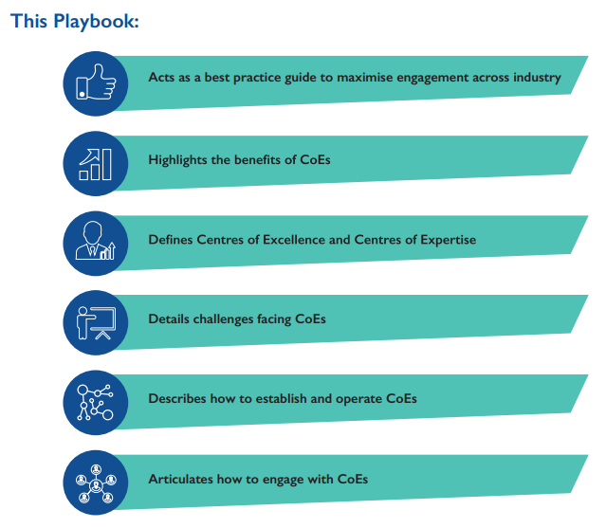
Centres of Excellence - Playbook
In collaboration with
CoE Playbook
Sponsored by the National Shipbuilding Office; developed in collaboration with Connected Places Catapult
Developed to provide guidance to Industry, Centres of Excellence & Government to outline best practices, operational guidelines, potential commercial models and case studies
Access Electronic CoE Playbook pdf version here
Provide a best practice guide to maximise engagement across the shipbuilding enterprise
Notes:
Centres of Excellence Playbook
The Centres of Excellence Playbook has been developed to provide guidance to Industry, Centres of Excellence & Government; outlining best practices, operational guidelines, potential commercial models and case studies
Aims to encourage growth, give clear guidance, create opportunities and drive change
The CoE Playbook is sponsored by the National Shipbuilding Office and developed in collaboration with Connected Places Catapult
The aim is to be able to provide useful advice for Industry to deepen their involvements with CoEs or vice versa; or for those seeking to enter or deepen their involvement with the UK shipbuilding enterprise
The CoE Playbook aims to encourage and support knowledge transfer, initiate and support collaborations, which are crucial to stimulate success and growth
The vision is for the CoE Playbook to be used in conjunction with the development of a CoE Digital Directory to provide a one-stop-shop to signpost what CoE capabilities exist and act as a conduit to access support, seek advice or request help on an issue.

Slide 10
Centres of Excellence – Community of Practice
In collaboration with
The success of all these efforts will be the appetite and willingness to engage and
build a Centres of Excellence Community of Practice
Aim:
Create a forum to drive an interactive CoE community of practice and build
an integrated Centre of Excellence Network
Encourage knowledge sharing, promoting collaborative behaviours & connections
Build industry awareness & collaboration for the use of the CoEs
Act as the communication channel to wider industry and society to provide a mechanism to signpost & increase visibility of CoE opportunities
SMI will lead the co-ordination of the Community of Practice with NSO sponsoring the endeavour
Profile & Promotion:
Establish on-line CoE Quarterly Forums for CoEs/Industry/Academia/Government to join
Run events nationally with COEs presenting to industry and government to build awareness and collaboration
Centres of Excellences can pitch their expertise; industry can bring their help needed /
call to action requests to the table and introductions can be made
COE collaborative marketing (LinkedIn primary focus)
CoE
Community of Practice
Act as the communication channel to wider industry & government to provide a mechanism to signpost & increase visibility of CoE opportunities
Notes:
Centres of Excellence Community of Practice
The success of all these efforts will be the appetite and willingness to engage and build a Centres of Excellence Community of Practice
SMI are going to lead the co-ordination of the Community of Practice with NSO sponsoring the endeavour
The aim is to establish on-line CoE Quarterly Forums for CoEs/Industry/Academia/Government to join
Centres of Excellences can pitch their expertise; industry can bring their help needed/call to action requests to the table and introductions can be made
This way, momentum will build and grow a strong collaboration to deliver benefits to the Shipbuilding Enterprise

Slide 11





Centres of Excellence - Principles
VISIBILITY OF NATIONAL CAPABILITY
Provide an informed alignment of
industry needs with existing Centres of Excellence through a CoE Digital Directory
LEVERAGE INCUMBENT STRENGTHS
Build on the UK’s capabilities while moving towards in-country provision vs strategic needs
LEVERAGE UK INNOVATION
Strengthen and maximise the UK offer to deliver innovative solutions.
Build on UK investment in both the Shipbuilding Enterprise and cross-sector innovation capability.
1+1>2
AVOID DUPLICATION
Make use of the existing landscape of established Centres of Excellence.
Concentrate efforts on aligning the UK landscape with the strategic needs of the national shipbuilding enterprise
A COLLABORATIVE APPROACH
Highlight the opportunities available to connect the Shipbuilding Enterprise community together. Build new linking mechanisms to demonstrate added value from collaboration & enhance opportunities
A CONSISTENT PLAYBOOK
Provide transparent, clear and concise guidance on creating part of the shipbuilding enterprise Centres of Excellence network, how to develop, and how to operate.

Slide 12
Centres of Excellence – Benefits Perspectives
Enhance growth
& build resilience of the Shipbuilding Enterprise
Industry
Centres of Excellence
Government
Industry
Build a better awareness of knowing what
Centres of Excellence exist
Get help on challenges to be resolved
Encourage collaboration between
industry & Centres of Excellence to
work towards shared outcomes
SMEs to larger organisations work in
collaboration with CoEs to help solve challenges
Identify what Industry wants out of a Centre of Excellence to meet the Shipbuilding Enterprise needs​, now & the future
Centres of Excellence
Share best practice & lessons learned
Encourage further collaboration,
connections & knowledge sharing
Identify linkages, synergies, common challenges, opportunities between
Centres of Excellence &/or Industry
Enhance growth and impact of
Centres of Excellence
Provide support to encourage future development
Government
Build knowledge and awareness to help guide policies
through a collaborative approach by identifying relevant
trends and drivers to inform direction
Provide support mechanisms to Centres of Excellence / Industry to encourage growth
Better understand demand from Centres of Excellence, Industry, Government Bodies & Customers
to identify gaps/future opportunities for the UK Shipbuilding Enterprise
Maximise cross-sector engagement to support a joint national endeavour
Notes:
To close, would like to highlight the benefits of engagement across each area.
From an Industry perspective – 1) build a better awareness of knowing what Centres of Excellence exist and 2) get help to resolve certain challenges.
From Small and Medium Enterprises through to larger organisations, or from within related industries looking at how they can collaborate with CoEs to help solve challenges.
From a Centres of Excellence perspective - share best practice & lessons learned and encourage further collaboration, with the opportunity to build connections & knowledge sharing with industry and government.
This is for organisations which are already an existing CoE; or seeking to become a CoE.
From a Government perspective – build knowledge and awareness to guide policies through a collaborative approach by identifying relevant trends and drivers to inform direction.
Also to better understand demand from industry to identify gaps/future opportunities.
The overall aim is to enhance growth and build resilience for our Shipbuilding Enterprise
And to repeat - the success of all these efforts will be the appetite and willingness to engage and build a Centres of Excellence Community of Practice.
THANK YOU FOR YOUR TIME TODAY ☺

